Slide 1

Image Caption Generation
Using Deep Learning
Course: Machine Learning (22ECSC306)
Team 02
Name | USN
Kushagra Tomar | 01FE20BCS063
Rakshita Bandi | 01FE20BCS076
Mayuri Kalmat | 01FE20BCS095
Pranav Jadhav | 01FE20BCS099

Slide 2

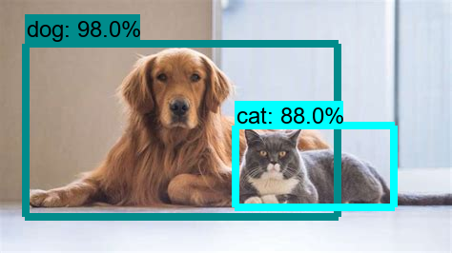


Deep Neural Network
A Deep Neural Network (DNN) is an Artificial Neural Network (ANN) with multiple layers between the input and output layers. DNN has power to mimic human brain to process image, speech etc.
Deep neural networks have many useful applications such as automatic speech recognition, Natural language processing, image recognition etc.

Slide 3
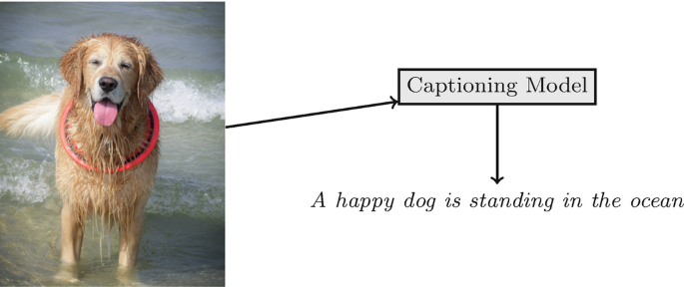
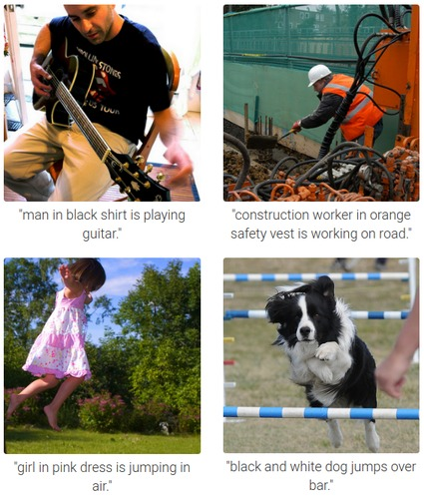

Image Caption Generation
Image Caption Generation has always been a study of great interest, being able to program a machine to accurately describe an image and how an object interacts with the surroundings like an average human. It has major applications in the field of robotic vision, search engine and many more.

Slide 4
Problem Statement
To build an optimal system which can generate semantically and grammatically accurate captions for a given image using appropriate encoder-decoder architecture.

Slide 5




Motivation
Image Caption Generator could help visually impaired people better understand the content of images on the web.
It could provide more accurate and compact information of images/videos in scenarios such as image sharing in social network or video surveillance systems.
The description of an image must involve not only the objects in the image, but also relation between the objects with their attributes and activities shown in images.

Slide 6
Objectives
To generate meaningful and grammatically valid captions for a given image.
To develop an efficient image captioning model using encoder-decoder architecture.
To utilize the attention mechanism in improving the efficiency.
To focus on sensitive local features of images while generating the captions.

Slide 7

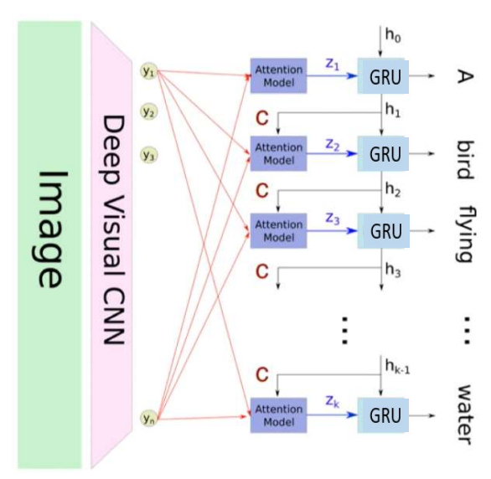
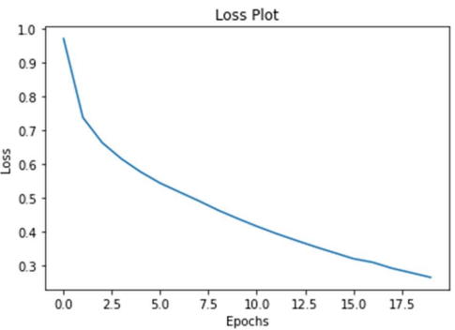
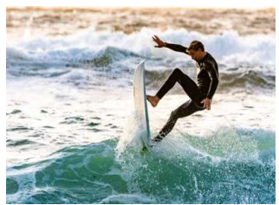
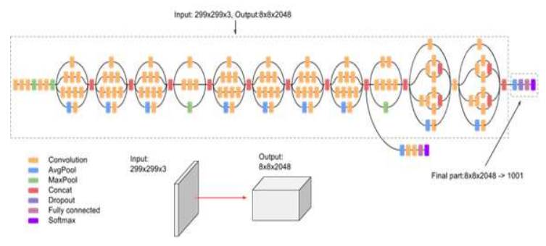
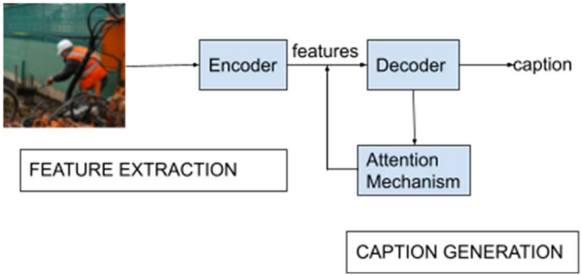
Image Caption Generator Using Attention Mechanism
Authors: Vaishnavi Agrawal, Shariva Dhekane, Neha Tuniya, Vibha Vyas
TM
Methodology
Generating captions for images is crucial for many conglomerates like Google to enhance the search experience by allowing users to search by images. Social media platforms like Facebook, Twitter, Instagram, and Snapchat also employ this kind of image captioning to help monitor which user likes what kind of posts. This system can be used for scene-to-text conversion for people with visual disabilities later converted to speech.
Results
Introduction
Proposed Model
For the encoder, Convolutional Neural Networks (CNN) will be used, as features are to be extracted from images. Pre-trained InceptionV3 is used as the CNN. Since InceptionV3 is an object-detection deep network, it needs to be tweaked a little to work as an encoder. To get a feature vector from this deep network, the final is removed and a feature vector of size (8x8x2048) is obtained. The feature vector extracted from this CNN will be fed to a Recurrent Neural Network (RNN). A Gated Recurrent Unit (GRU) is used as the RNN for decoding. Bahdanau attention is used as the attention mechanism, to generate more focused captions.
Fig. 4. Loss versus Epoch plot
Fig. 2. Overall model architecture
Predicted caption– a young man is on a surf board on a wave
Conclusion
The training data and the corresponding vocabulary was limited, the model might fail to identify objects from input scenes that do not feature in its vocabulary.
Fig. 3. Convolutional Neural Network architecture
Fig. 1. Flowchart for image caption generator.

Slide 8
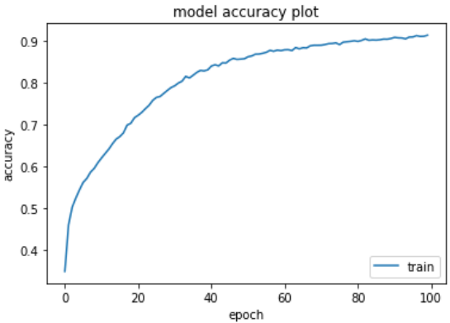
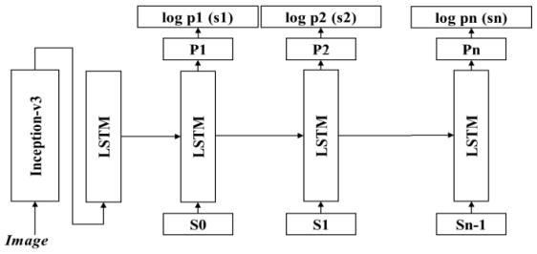
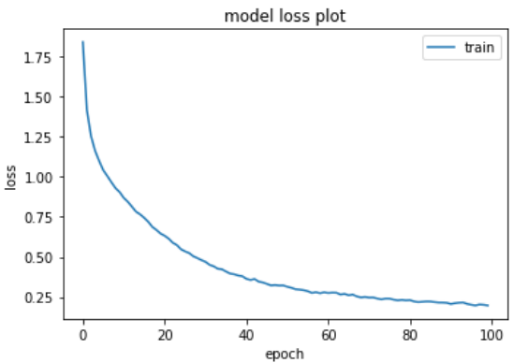
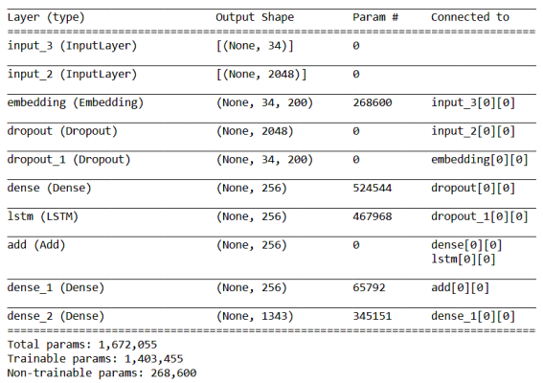
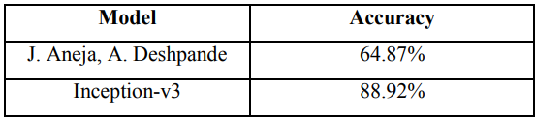
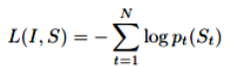
Image Captioning Using Inception V3 Transfer Learning Model
Authors: Sheshang Degadwala, Dhairya Vyas, Haimanti Biswas, Utsho Chakraborty, Sowrav Saha
TM
Methodology
This article, examine an interesting multi-modal dilemma in which Image Captioning is the most useful Deep Learning technology. A picture title is the manner in which text descriptions based on objects and image behavior can be generated from an image. This technique can be used in a wide variety of real-life applications
Results
Introduction
Proposed Model
In the proposed model, input is sent to the model Inception-v3 and the output received is sent to a new completely connected layer introduced at the end of the model Inception-v3. The layer convert the output of the model into a word embedding vector. This is fed into an LSTM cell sequence by embedding vector. The LSTM cell may rely on sequences of information and accumulate them over time. This helps to construct meaning full captions.
During the training, a pair of photos and subtitles are shown to the model. The start-v3 component of the model is taught to identify all possible object in image. In the LSTM portion, each word is predicted in the picture using previous words in a phrase. The objective of training is to reduce the failure function .
The dataset used was filker8k which has 8,000 images combined with five separate captions that offer concise explanations of the salient individuals and events.
Fig. 3. Accuracy versus Epoch plot
Fig. 1. Proposed Model Architecture
Fig. 4. Loss versus Epoch plot
Conclusion
Fig. 2. Model Summary
This Proposed system can autonomously interpret an image and provide a rational definition with 88.92% accuracy compared to other CNN methods which gives 64.87% accuracy

Slide 9
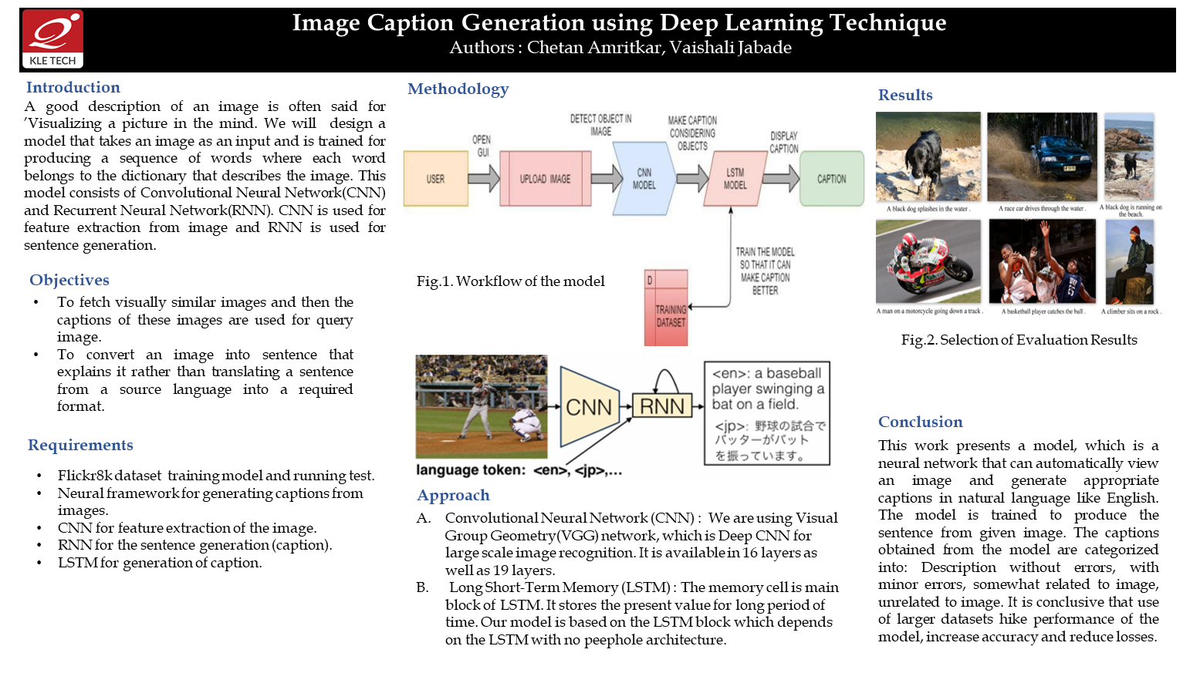

Slide 10
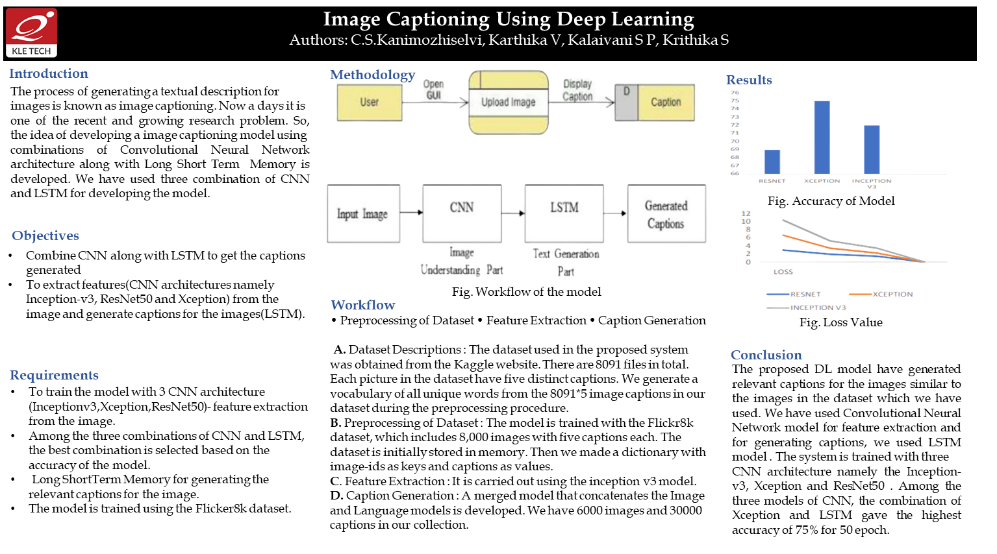

Slide 11
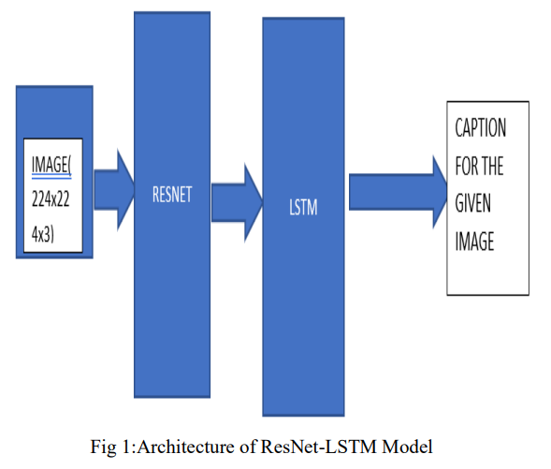
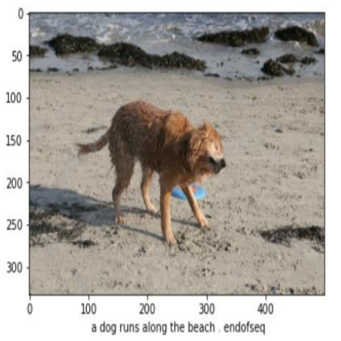
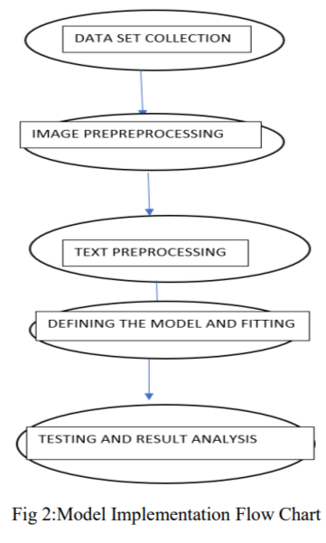
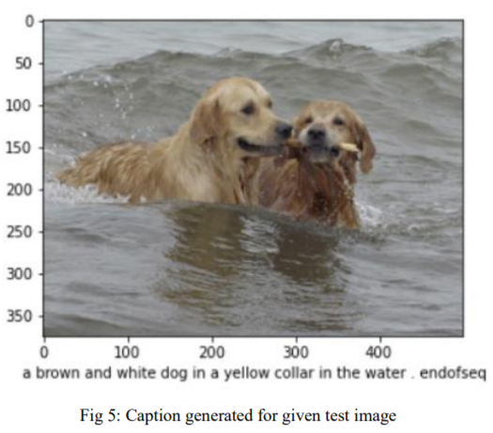
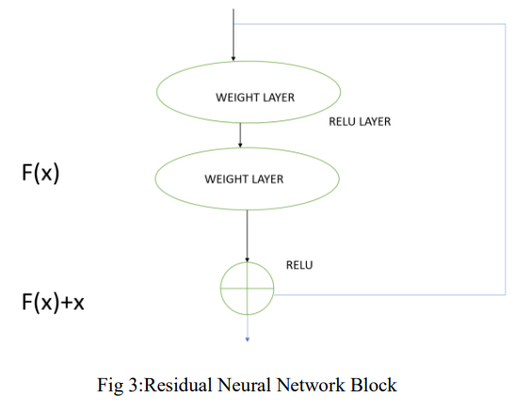
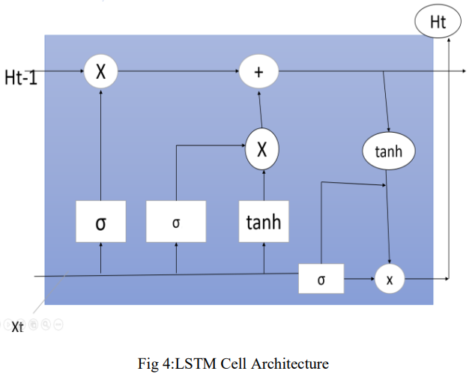
Image Caption Generating Deep Learning Model
Authors: Aishwarya Maroju, Sneha Sri Doma, Lahari Chandarlapati
TM
Methodology
Introduction
Test Outputs
Image caption generation is useful in analysis of large amount of unlabeled data, self-driving cars and to guide blind people.
The existing CNN-RNN models are hindered by vanishing gradient problem.
To overcome it, the authors of this paper have applied ResNet-LSTM [encoder-decoder] technique for image captioning.
They have used FLICKR 8k dataset.
Proposed System
The five steps in proposed system:
Data set collection: FLICKR 8k data set contains 8000 images and each image has five descriptions of the content present in it.
Image preprocessing: Resizing every image to 224X224X3 to maintain uniform size. Also converting into RGB using cv2 library.
Text preprocessing and Vocabulary building: Removing numbers, converting upper case letters to lower case, attaching <start seq> and <end seq> at extreme sides of each caption. The words are now numbered sequentially as per dictionary.
Defining and testing the model: ResNet extracts image features and converts them into single layered vector [encodes]. LSTM takes image features and vocabulary dictionary to generate each word sequentially[decodes].
Result analysis: meaningful captions begin to generate after minimum 20 epochs.
Results and Conclusion
When the model is trained for 50 epochs, the accuracy is poor in initial epochs and accuracy increases after 20 epochs.
This ResNet-LSTM model is better is more accurate than CNN-RNN and VGG models.
Future scope to extend this model to build image-speech conversion.

Slide 12
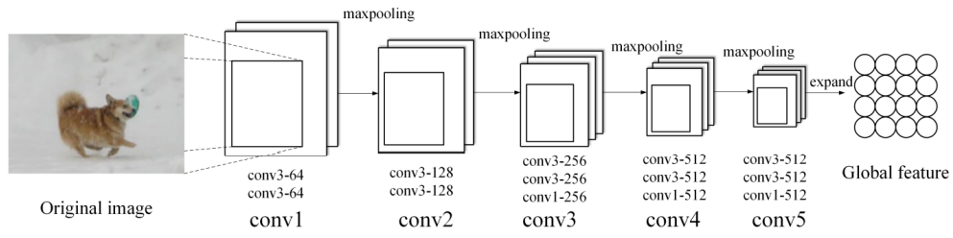
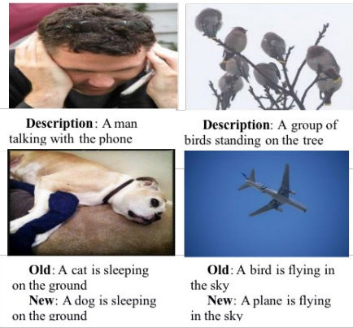
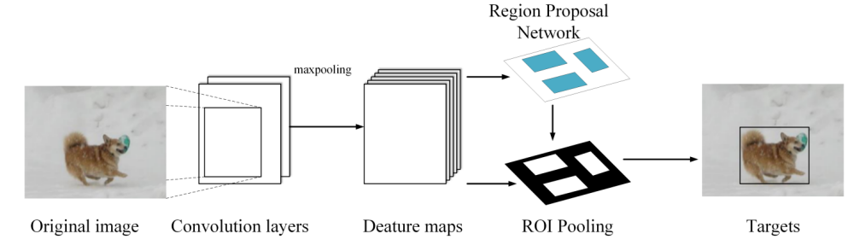
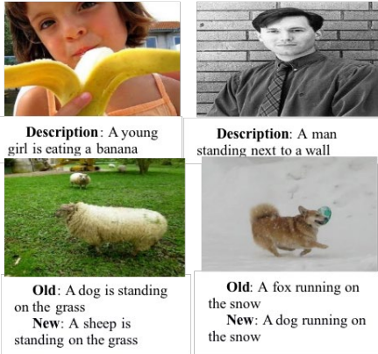
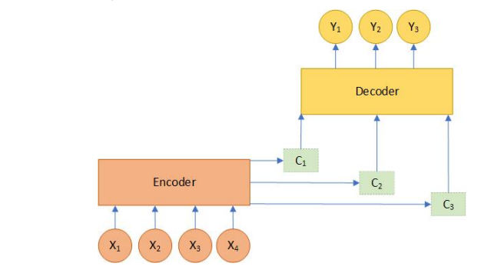
Encoder-Decoder Based Multi-Feature Fusion Model for Image Caption Generation
Authors: Mingyang Duan, Jin Liu and Shiqi Lv
TM
Methodology
Introduction
Test Outputs
Image caption generation is an important aspect in computer vision.
The existing models limit themselves to the global features. Thus, local features of images remains untouched.
The authors have used multiple neural networks such as VGG 16, Faster R-CNN and bidirectional LSTM network in their model to work on fused features.
They have used ImageNet, Pascal VOC and MSCOCO datasets
Fig 1: The structure of VGG 16 for the global feature extraction of images
Proposed System
Fused image feature extraction: VGG16 network for global feature extraction and Faster-RCNN for local features extraction.
Bi-LSTM with Attention Mechanism: Encoder extracts global feature and local feature and outputs the mixture feature. The mixture feature is sent through attention layer as an input to the Bi-LSTM.
Text correction: The representation of each word can be used to calculate contextual relation of the word through Bi-LSTM unit.
Fig 2: The specific steps of object detection by a Faster-RCNN
Experiment
Results and Conclusion
VGG 16 model is trained with ImageNet dataset. Images are scaled to the size of 224*224*3. Mean filtered to denoise.
Faster-RCNN trained with the Pascal VOC dataset. Numbers of anchors in RPN set as 256 and 1:1 positive and negative sample ratio maintained.
Bi-LSTM trained with MSCOCO dataset.
The test accuracy in training set: 78.2%
The test accuracy in verification set: 66.5%
The fused features have proven to be superior to either global features or local features alone.
The text correction method is also proved to be feasible.
Fig 3: The structure of the encoder-decoder model with attention mechanism

Slide 13
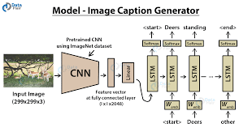
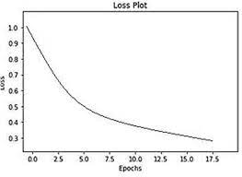
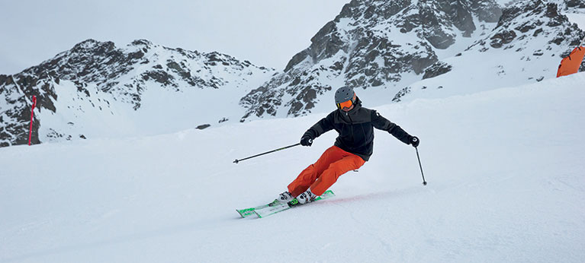
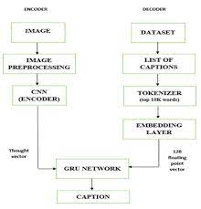
Image Caption Generator Using Inception V3 and GRU
Authors: : Manish Raypurkar, Abhishek Supe, Pratik Bhumkar, Pravin Borse, Dr. Shabnam Sayyad
TM
Methodology
Automatically describing the content of images using natural languages is a fundamental and challenging task. Human beings usually describe a scene using natural languages which are concise and compact. However, machine vision systems describes the scene by taking an image which is a two dimensional arrays. The idea is mapping the image and captions to the same space and learning a mapping from the image to the sentences.
Results
Introduction
Proposed Model
For the encoder part, we use Inception V3 model created by Google Research. The extractor produces L vectors, each of which is a D-dimensional representation corresponding to a part of the image: A decoder is employed to translate the image into natural sentences.GRU is used as a decoder which has a simpler structure than LSTM.
Fig. 4. Loss versus Epoch plot
Fig. 2. Overall model architecture
Predicted caption– A person riding skis on a mountain
Conclusion
Our model is based on multi label classification using fast Text and CNN, is useful in detecting and extracting objects from image and generate caption according to the provided datasets.
Fig. 1. Flowchart for image caption generator.
Fig. 3. Convolutional Neural Network architecture

Slide 14
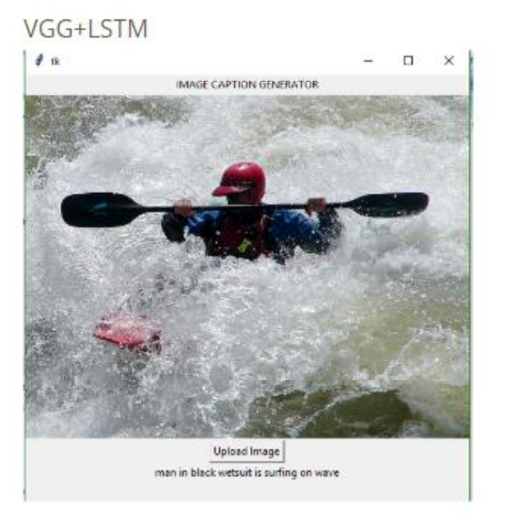
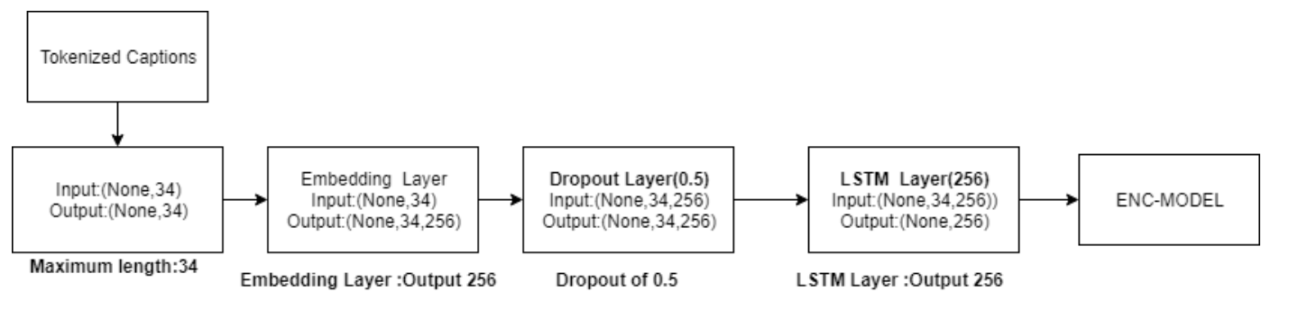
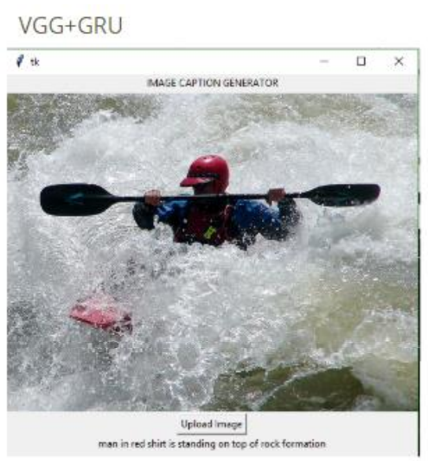
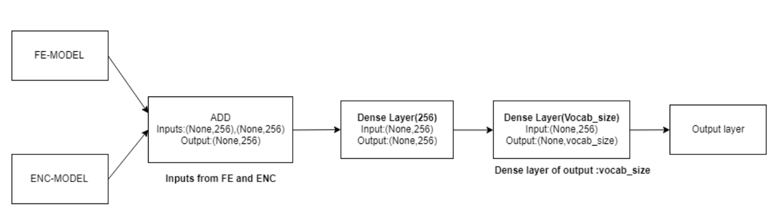
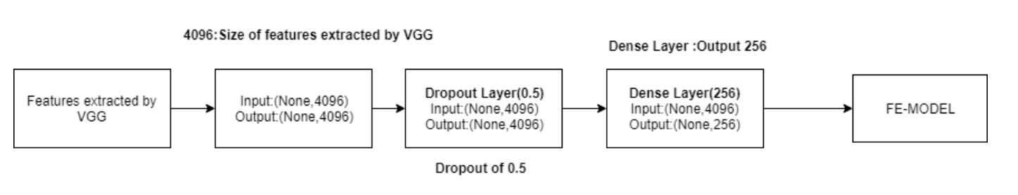
Image Caption Generator Using VGG+LSTM and VGG+GRU
Authors: : Grishma Sharma , Priyanka Kalena, Nishi Malde, Aromal Nair, Saurabh Parkar
TM
Methodology
.
Generating accurate captions for an image has remained as one of the major challenges in Artificial Intelligence and has always been a study of great interest to the researchers. Being able to program a machine to accurately describe an image or an environment like an average human has major applications in the field of robotic vision, business and many more.
Results
Introduction
Proposed Model
For the Encoder model, LSTM layer or Long Short Term Memory Layer is used.This layer helps the model in learning how to generate valid sentences or generating the word with highest probability of occurrence after a specific word is encountered. The decoder model is basically the model which concatenates both the feature extraction model and encoder model and produces the required output which is the predicted word given an image and the sentence generated till that point of time.
A man in black swimsuit is surfing on the wave
Fig. 2. Encoder model
Predicted caption– A person riding skis on a mountain
A man in red shirt is standing on top of a rock formation
Conclusion
Results show that LSTM model generally works slightly better than GRU although taking more time for training and sentence generation due to its complexity.
Fig. 1. Feature Extraction model
Fig. 3.Final Decoder model

Slide 15
References
[1] V. Agrawal, S. Dhekane, N. Tuniya and V. Vyas, "Image Caption Generator Using Attention Mechanism," 2021 12th International Conference on Computing Communication and Networking Technologies (ICCCNT), 2021, pp. 1-6, doi: 10.1109/ICCCNT51525.2021.9579967.
[2] S. Degadwala, D. Vyas, H. Biswas, U. Chakraborty and S. Saha, "Image Captioning Using Inception V3 Transfer Learning Model," 2021 6th International Conference on Communication and Electronics Systems (ICCES), 2021, pp. 1103-1108, doi: 10.1109/ICCES51350.2021.9489111.
[3] C. Amritkar and V. Jabade, "Image Caption Generation Using Deep Learning Technique," 2018 Fourth International Conference on Computing Communication Control and Automation (ICCUBEA), 2018, pp. 1-4, doi: 10.1109/ICCUBEA.2018.8697360.
[4] C. S. Kanimozhi Selvi, K. V, K. S. P and K. S, "Image Captioning Using Deep Learning," 2022 International Conference on Computer Communication and Informatics (ICCCI), 2022, pp. 1-7, doi: 10.1109/ICCCI54379.2022.9740788.
[5] Aishwarya Maroju , Sneha Sri Doma , Lahari Chandarlapati, 2021, Image Caption Generating Deep Learning Model, INTERNATIONAL JOURNAL OF ENGINEERING RESEARCH & TECHNOLOGY (IJERT) Volume 10, Issue 09 (September 2021),
[6] Kabbai, L., Abdellaoui, M. & Douik, A. Image classification by combining local and global features. Vis Comput 35, 679–693 (2019). https://doi.org/10.1007/s00371-018-1503-0
[7] Pranay Mathur, Aman Gill, Aayush Yadav, Anurag Mishra and Nand Kumar Bansode (2017) International Conference on Computational Intelligence in Data Science(ICCIDS)
[8] CS771 Project Image Captioning by Ankit Gupta , Kartik Hira, Bajaj Dilip.

Slide 16
Thank You!

